Slide 1

HR Analytics Employee Retention

Slide 2
GROUP MEMBERS
SAIPRIYA
JEEVANA
FUAAD SANEEN
KARTHIKEYA
SREERAM
CHITRANJAN
SHAIK SADIK

Slide 3
OVERVIEW:
Introduction
KPI 1- Average Attrition Rate for all departments
KPI 2 - Average hourly rate of male research scientist
KPI 3 - Attrition rate Vs monthly income stats
KPI 4 - Average working years for each Department
KPI 5 - Job role Vs work life balance
KPI 6 – Attribute Rate Vs year since last promotion relations
Excel Dashboard
Power Bi Dashboard
Tableau Dashboard
SQL
Challenges Faced
Conclusion

Slide 4
Introduction:
The HR Analytics Dashboard for Employee Retention offers a comprehensive view of key metrics and indicators, such as turnover rates, tenure distribution, satisfaction scores, and engagement levels. Through interactive visualizations and customizable dashboards, HR leaders can drill down into specific departments, job roles, or demographic groups to uncover insights that inform targeted retention strategies.
By analyzing factors such as job satisfaction, work-life balance, career advancement opportunities, and manager effectiveness, HR professionals can pinpoint areas for improvement and implement targeted interventions to enhance employee engagement and loyalty.

Slide 5




Tools Used
MS EXCEL
TOOLS

Slide 6
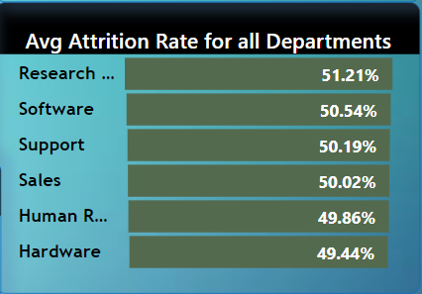
KPI 1- Average Attrition Rate for all departments:
The pie chart shows the average rate of attrition in all the departments
The Research & Development department show the highest (51.21%) of attrition rate, whereas Hardware department shows lowest (49.44%) rate of attrition.

Slide 7
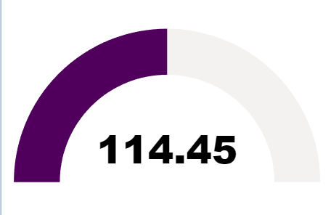
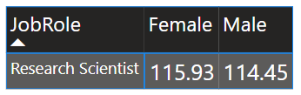
KPI 2 – Average hourly rate of male research scientist:
The average hourly rate of male research scientist is 114.45 which is slightly less than the average hourly rate of female research scientist (115.93).

Slide 8
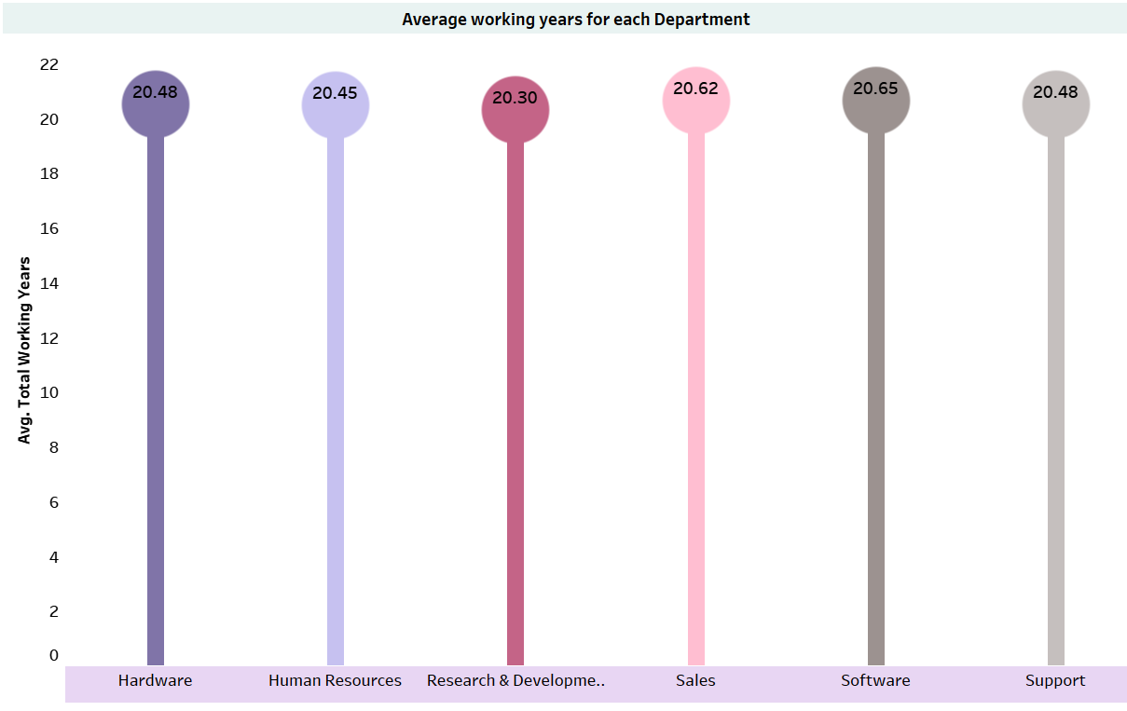
KPI 4 – Average working years for each Department :
Below is the visualization that shows the average working year for each department.
Visualization is the combination of bar chart and circle, where circle shows the data in it.
Among departments, Software boasts the highest average working years (20.62 years), while R&D shows the lowest (20.30 years).

Slide 9
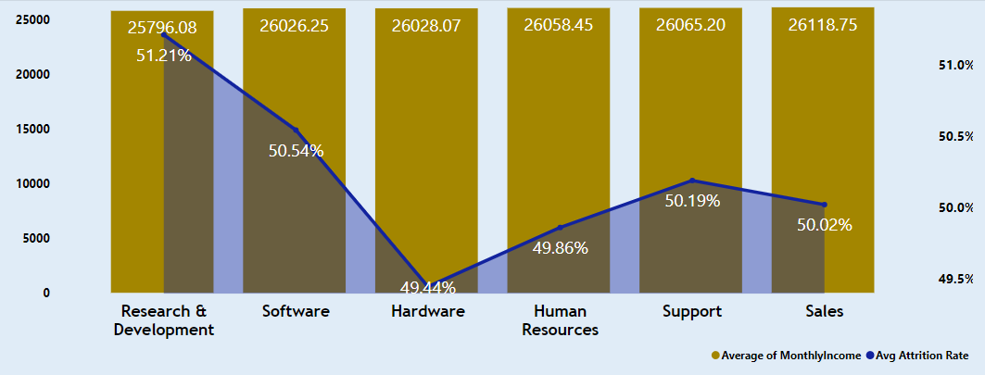
KPI 3 – Attrition rate vs monthly income stats :
This KPI explores the relationship between employee attrition rates and their monthly income. The goal is to identify any trends or insights that can help the HR team better understand factors contributing to employee retention.
The data reveals an inverse relationship between monthly income and attrition rate, Employees earning higher salaries exhibit lower turnover.

Slide 10
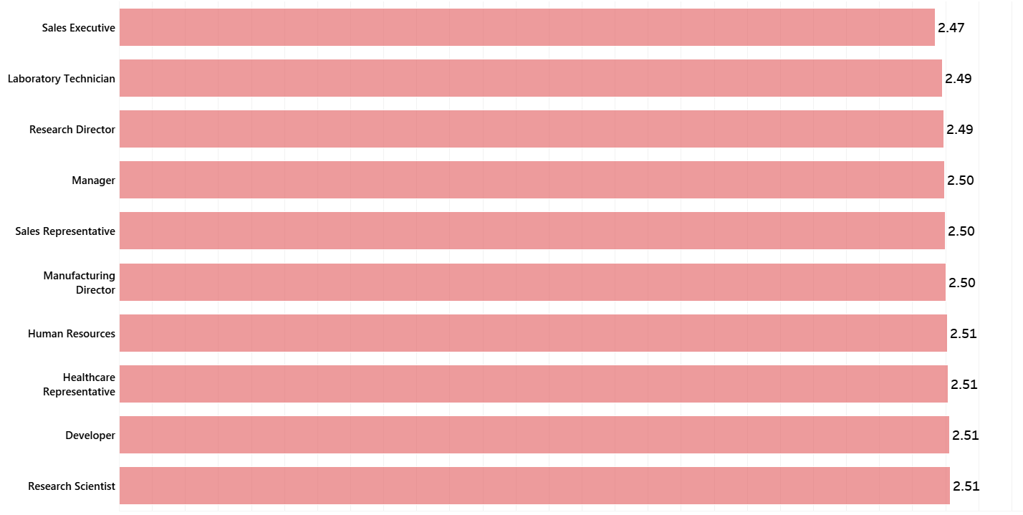
KPI 5 – Job role vs work life balance :
Work-life balance is measured on a scale of 1 to 4, with 4 indicating the best balance and 1 indicating worst balance.
Research Scientists tend to report the highest work-life balance scores, while Sales Executives tend to report the lowest.

Slide 11

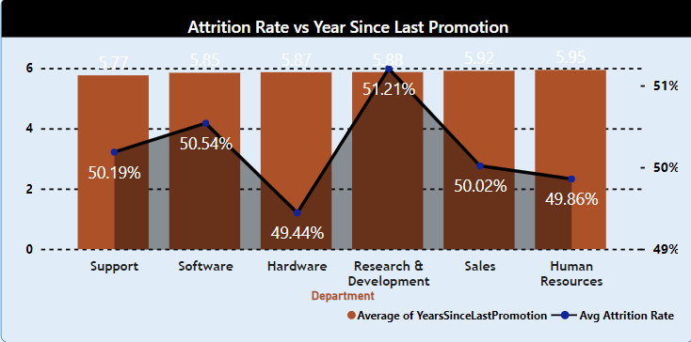
KPI 6 – Attrition rate Vs year since last promotion :
Below visualization is the dual axis chart that shows the relation between the attrition rate and year since last promotion.
The data shows a positive correlation between attrition rate and years since last promotion. Departments with longer tenures since their last promotion tend to have higher attrition rates.

Slide 12
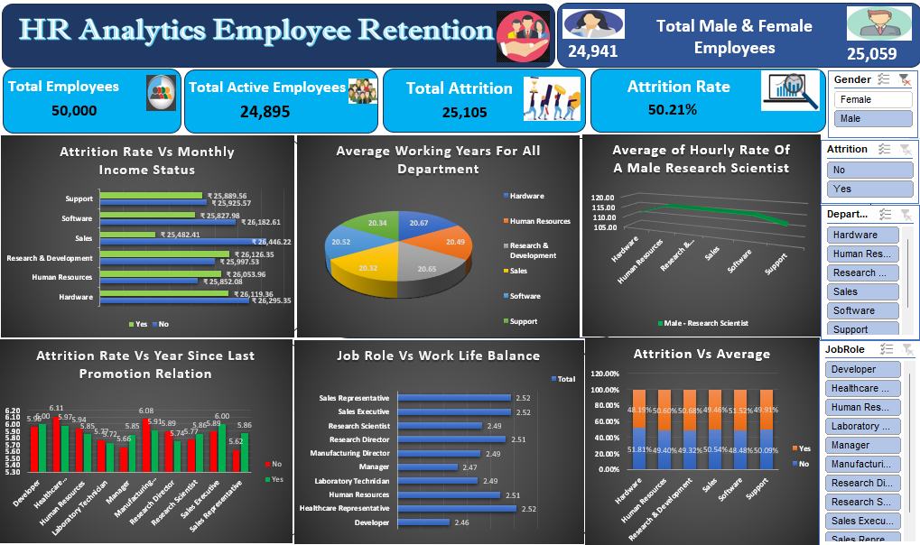
EXCEL DASHBOARD

Slide 13
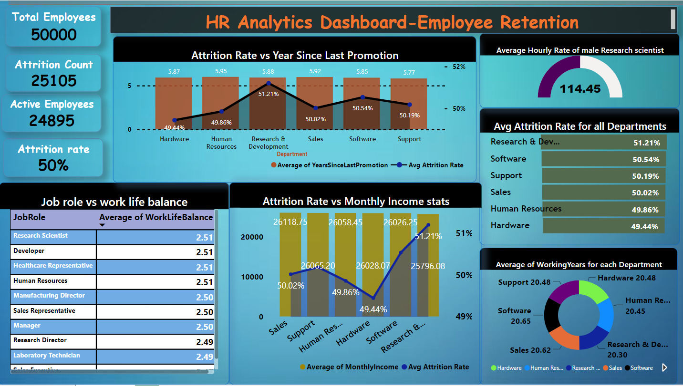
POWERBI DASHBOARD

Slide 14
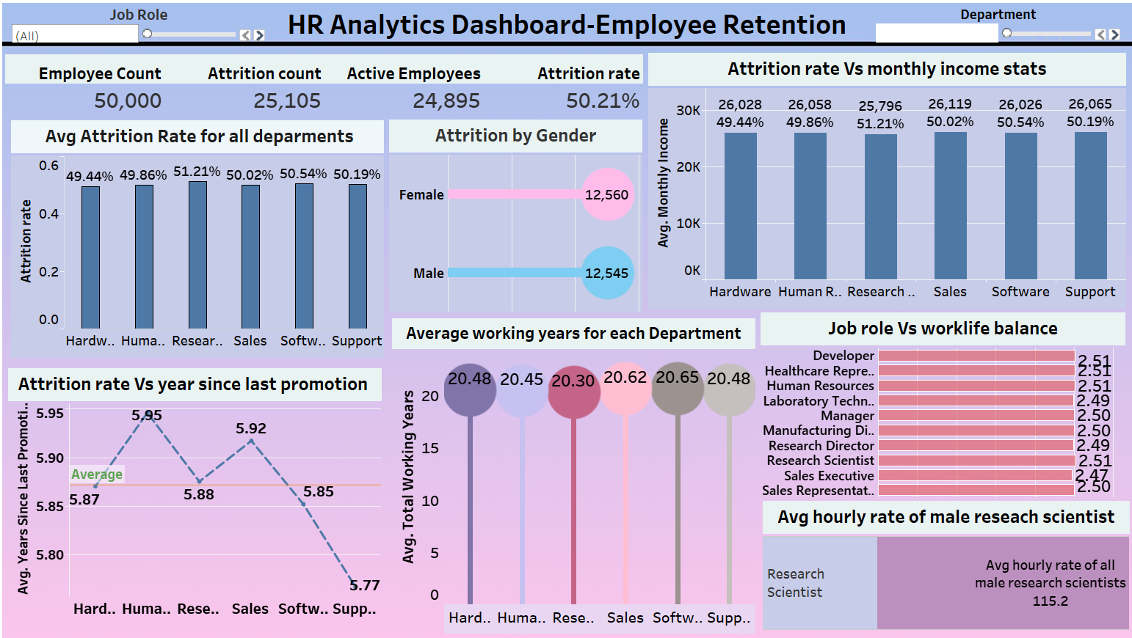
TABLEAU DASHBOARD

Slide 15
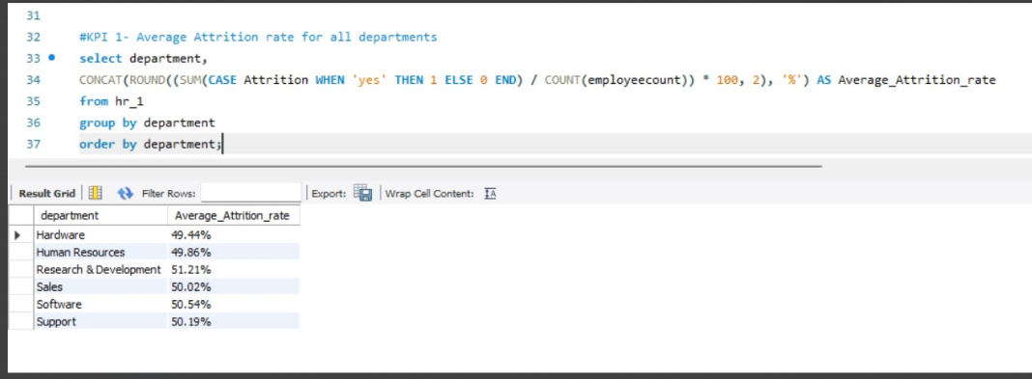
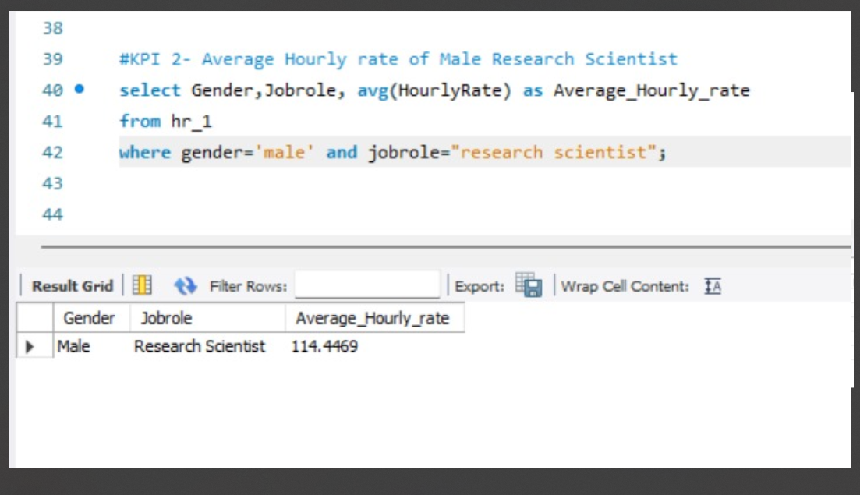

Slide 16
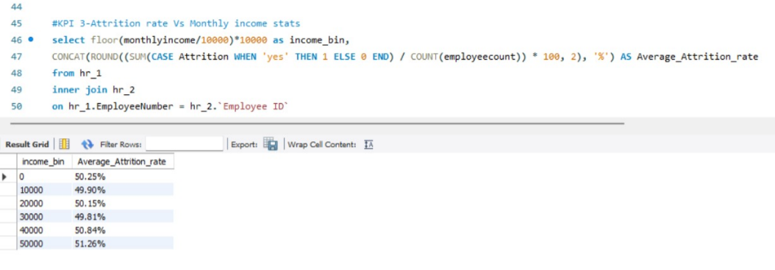
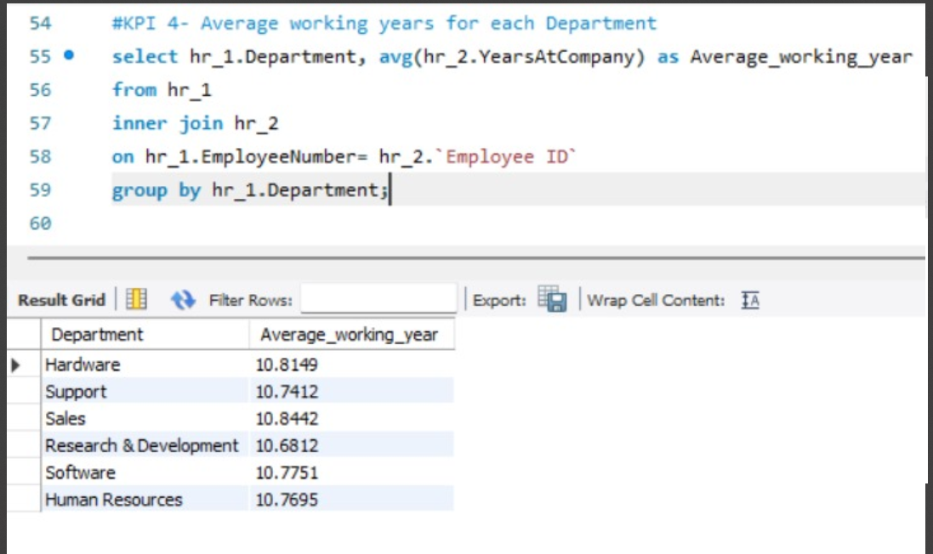

Slide 17
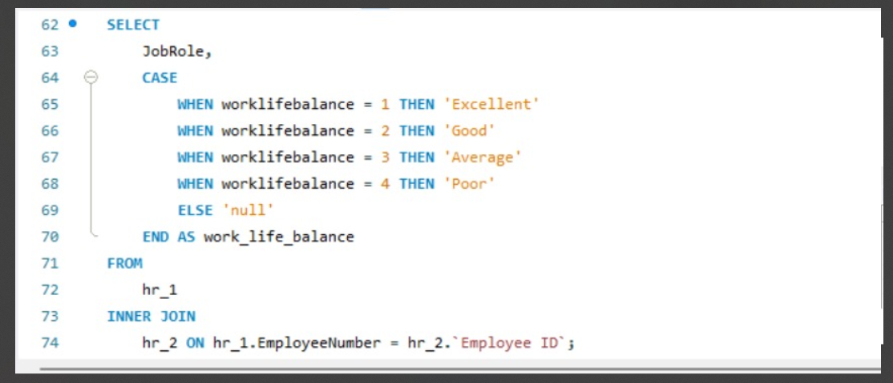
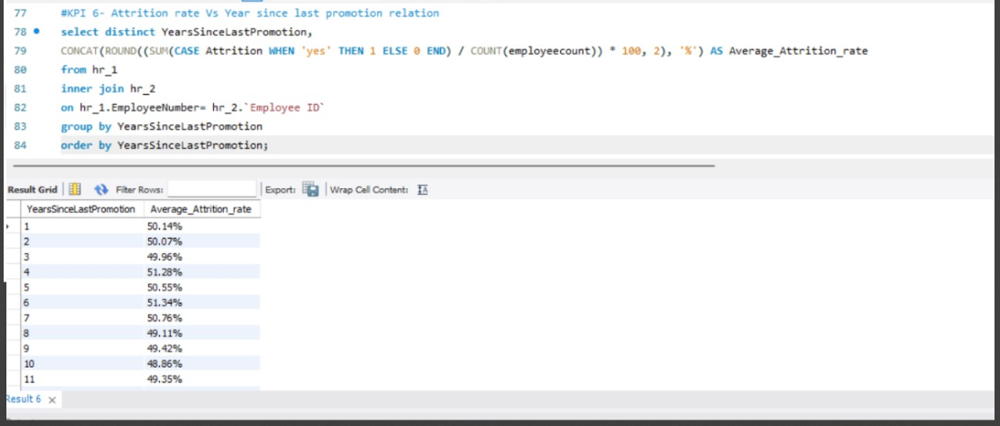

Slide 18
Challanges Faced :
Rigorously test to ensure it performs well and delivers accurate insights.
As your data grows beyond, the dashboard should be able to handle the increased load without breaking down.
Pre-aggregate the data before it reaches the dashboard to improve performance.
Ensure your data queries are efficient and only retrieve the necessary information.
Without proper optimization, the data could be slow to load and interact with this can be frustrating for users and defeat the purpose of a quick and informative display.

Slide 19
Outcome of the project:
:
The implementation of KPIs in Excel, Tableau and Power BI helped to gain proficiency with the application of these business analytics tools.
The group project taught us how to collaborate and work as a team to produce the output more effectively.
The weekly check points helped to plan the project in a better way which allowed to achieve the larger objectives.

Slide 20

Thank You

